Slide 1
DIGITAL OPPORTUNITIES IN THE COFFEE SUPPLY CHAIN
Diana Kaliff
Farmer Connect SA

Slide 2
Collaborative, industry-led initiative to create a global ecosystem Farmer Connect is using technology, such as blockchain, to create an ecosystem for smallholder farmer commodities that will drive efficiencies in the supply chain, while additionally connecting consumers more directly with the farmers that grow the products they enjoy.

Slide 3
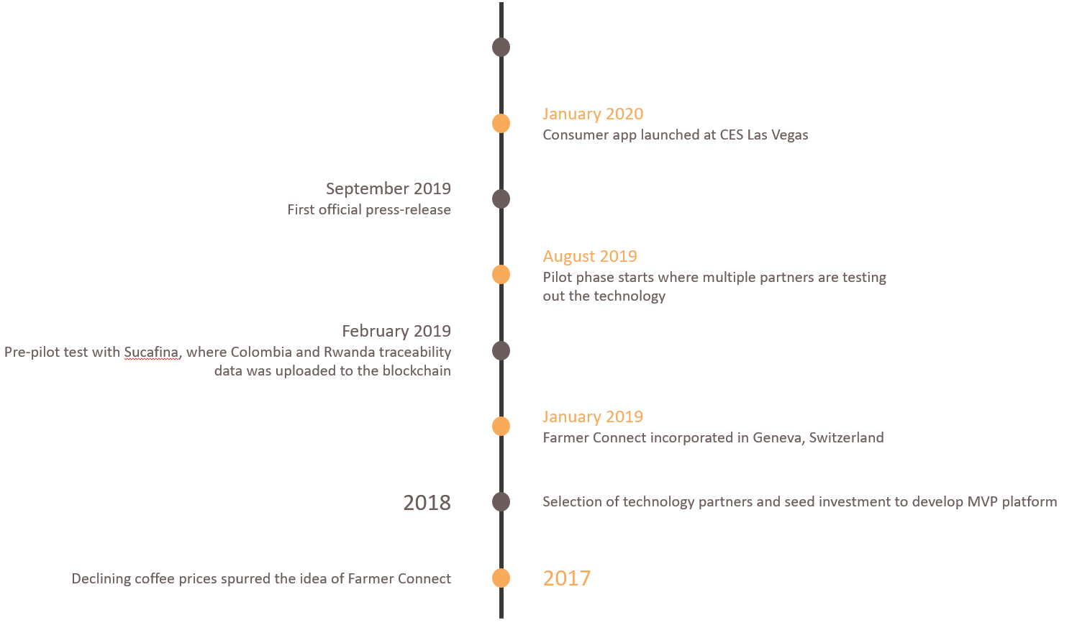
Timeline

Slide 4
Farmer Connect video

Slide 5
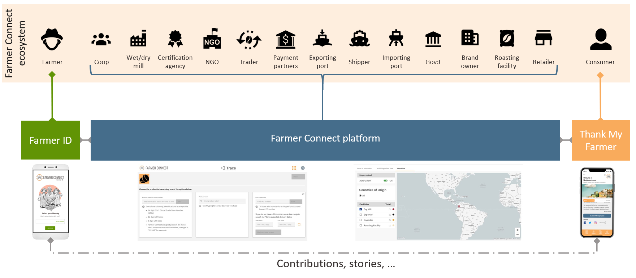
The ecosystem & our products

Slide 6
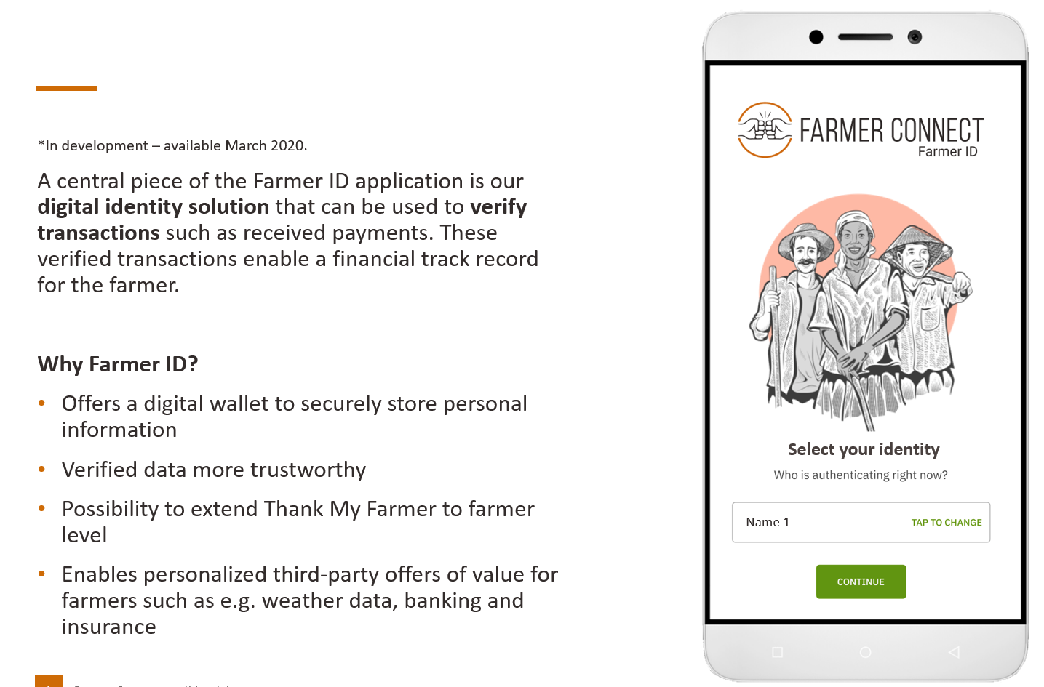
Farmer ID

Slide 7
Farmer Connect Platform

Slide 8
Thank My Farmer app

